Slide 1
Digital mammographic tumor classification using transfer learning from deep convolutional neural networks
Paper by: Benjamin Q. Huynh, Hui Li, Maryellen L. Giger
Presented by: Jeremy Hui

Slide 2
IntroDUCTION
Breast cancer – 2nd most common cancer diagnosed in women in the United States
Occurs when breast cells grow abnormally
Lesion – an area of abnormal tissue
CADe (detection – marking structures and sections) and CADx (diagnosis – evaluation of structures)

Slide 3
Computer-aided diagnosis (CADx)
Used in various radiological image analysis and precision medicine
To diagnose breast cancer using classification algorithms (lesion malignant or benign)
Lesion classification based on features extracted from image data

Slide 4
Approaches
Traditional
Extract clinically specified tumor features (e.g. shape and density)
Estimate malignancy probabilities based on hand-crafted lesion features
Alternative
Learn features directly from full images through methods (e.g CNN)
Yield hidden features with more information

Slide 5
Approach
Breast imaging CADx system based on deep neural networks with transfer learning
Transfer Learning is the reuse of a pre-trained model on a new problem
Hypothesized that structures within a CNN trained on everyday objects could be used to create a classifier for breast cancer CADx
Training CNNs from scratch limited by size and labels of data, computational resources

Slide 6
Approach
Pretrained CNN-extracted features (automatically)
Analytically extracted CADx features (manual)
SVM classifiers trained on each set
Ensemble classifier trained on both
ROC analysis and cross validation used to evaluate

Slide 7
DATA
Obtained from University of Chicago Medical Center
219 lesions on full-field digital mammography images
607 region of interest (ROI) extracted
512 x 512 box cropped around center, pixel size of 0.1mm
Number of ROIs per lesion varied between 1 – 13
Labeled as benign or malignant based on pathologic reports

Slide 8
Method A:Pretrained CNN Features
Publicly available version of AlexNet
Pretrained on ImageNet dataset (1M images and 1K classes)
Weights are preinitialized
11 layers from which features can be extracted
Zero-variance columns removed
Trained SVM classifiers using features from each layer

Slide 9
AlexNet

Slide 11
Method B: Analytically Extracted Features
Center of lesion manually indicated and automatic lesion segmentation performed within 512 x 512 ROI
H. Li et al., “Evaluation of computer-aided diagnosis on a large clinical full-field digitalmammographic dataset,” Acad. Radiol. 15(11), 1437– 1445 (2008)
Image features extracted (includes size, shape, intensity (e.g contrast and texture) and margin (e.g sharpness))
SVM classifier trained on extracted features

Slide 12
Method C: Ensemble Classifier
Outputs from both individual classifers (A&B) combined
Soft voting technique used
Soft voting output computed as
p₃ = [(p₁ + p₂)/2]
where p₁ and p₂ are output probability vectors from the individual classifiers

Slide 13
Classification
Preprocessing – centering and scaling each feature to have zero mean and unit variance
Classification – polynomial kernel defined as K(x,y) = (ax^{T}y +c)^{d}
Parameters a,c,d selected using cross validated grid-search with five folds

Slide 14
Evaluation
Receiver Operating Characteristics (ROC) analysis used to evaluate classifiers
Area under Curve (AUC) used as performance metric
Cross – validation conducted by lesion instead of ROI
T-tests to test for statistical significance between AUC scores with Bonferroni corrections

Slide 15
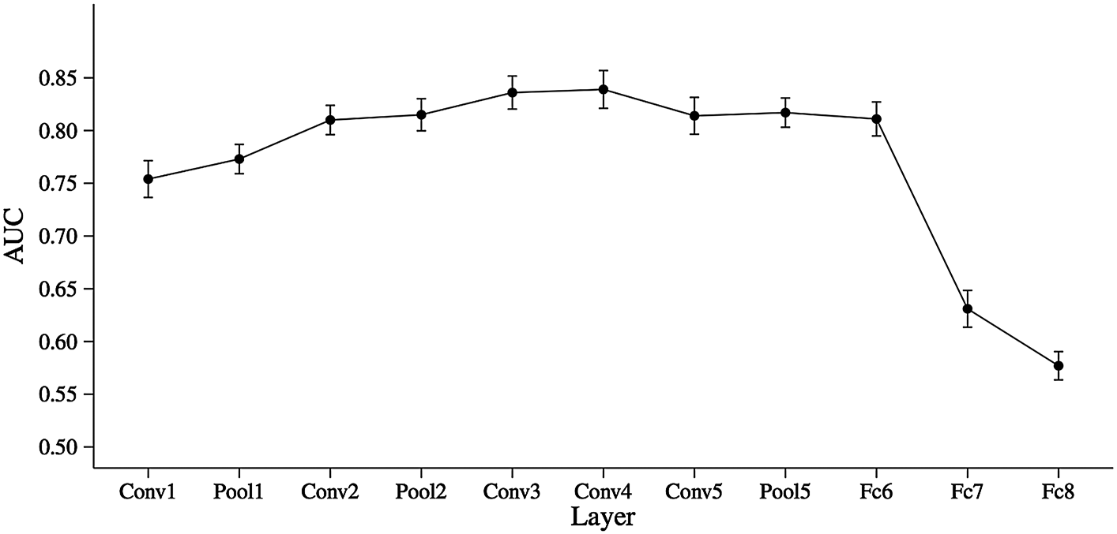
Results: Layer Comparisons

Slide 16
Results: Layer Comparisons
Peaks in performance at Conv4 layer
Drops in performance after FC6 layer
Difference in AUC small (0.81 vs 0.83)
FC6 layer chosen as optimal layer
High predictive performance and low dimensionality
FC6 (3795 x 1) vs Conv4 (79587 x 1)

Slide 17
Model Comparison and Evaluation

Slide 18
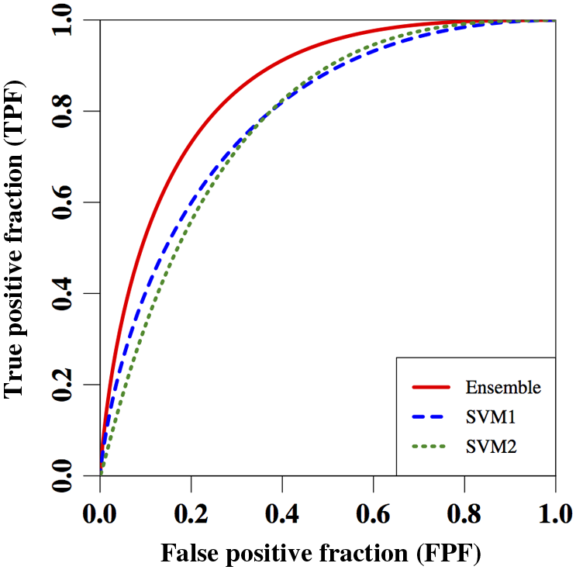
Model Comparison and Evaluation
Ensemble classifier better than classifer based on analytically extracted features after Bonferroni Correction
AUC = 0.86 vs AUC = 0.81, p = 0.022

Slide 19
Previous Works
CNN – extracted features
Y. Bar et al., “Chest pathology detection using deep learning with non- medical training,” in 2015 IEEE 12th Int. Symp. on Biomedical Imaging (ISBI), pp. 294–297, IEEE (2015).
Y. Anavi et al., “A comparative study for chest radiograph image retrieval using binary texture and deep learning classification,” in 2015 37th Annual Int. Conf. of the IEEE Engineering in Medicine and Biology Society (EMBC), pp. 2940–2943, IEEE (2015).
Ensemble methods
H. Wang et al., “Mitosis detection in breast cancer pathology images bycombining handcrafted and convolutional neural network features,” J. Med. Imaging 1(3), 034003 (2014)

Slide 20
Limitations
Large, annotated images required
CNNs trained for specific task might achieve better results
Pretrained CNN restricts to original architecture
Simplicity was key with regards to CNN and ensembling technique

Slide 21
Conclusion and future improvements
Transfer learning from nonmedical tasks can improve current methods of classification for CADx
Comparison between CNN extracted features and human designed features allow for better interpretation of CADx output
Other networks known for transfer learning could be used
K. Simonyan and A. Zisserman, “Very deep convolutional networks for large-scale image recognition,” arXiv preprint arXiv:1409.1556 (2014)
Explore how different classifiers relate to specific physical qualities of lesions

